Slide 1
Technological Solutions to Mitigate Airborne Transmission of Infectious Diseases in the Built Environment
Dan Le, Shane Chung, Sowon Jung, Yiming Wang

Slide 2
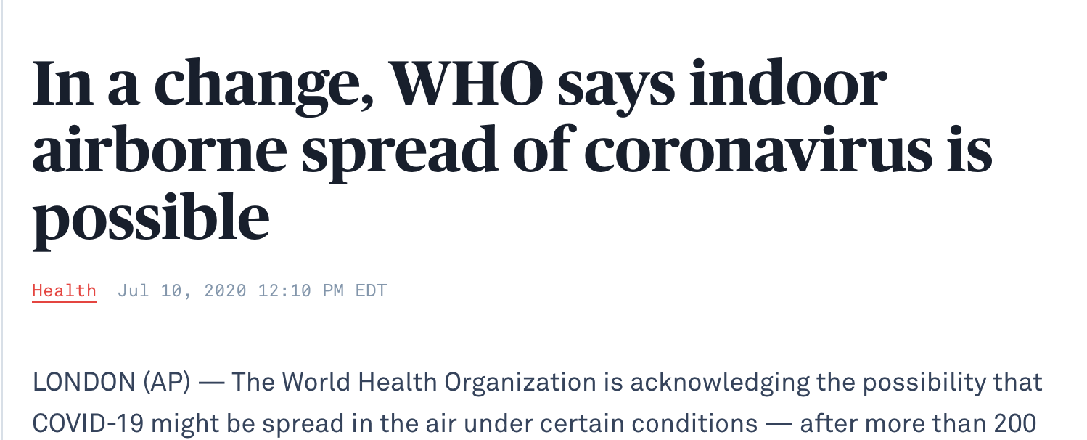
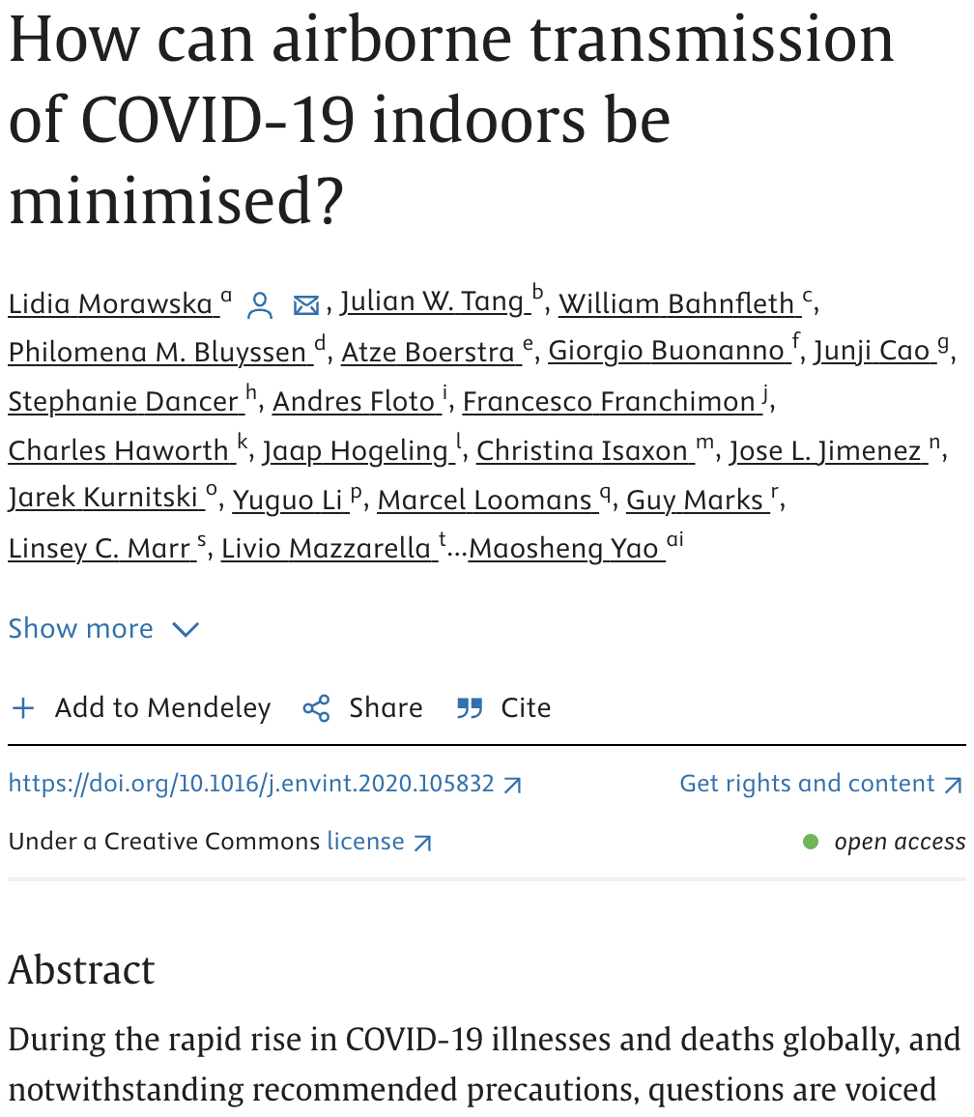
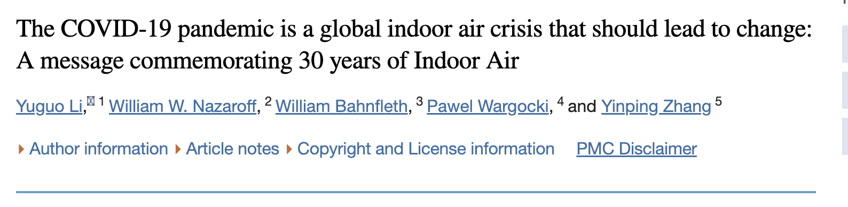
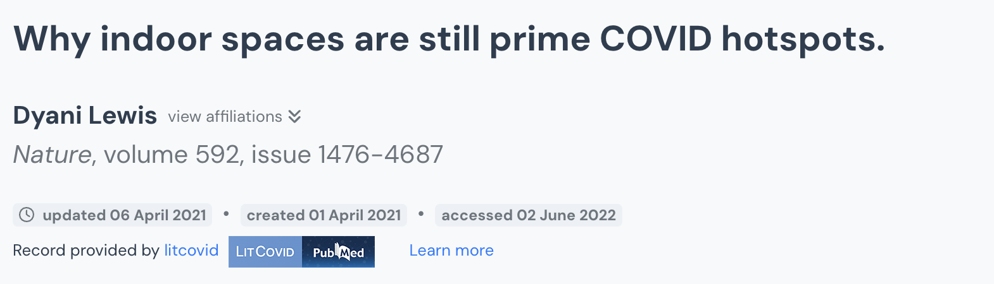
Problem Addressing
Notes:
Today, we'll be exploring an essential and timely issue: the minimization of airborne transmission of COVID-19 within indoor environments.
Our discussion will be grounded in the latest research and findings from various studies, including significant insights from authorities like the World Health Organization, which has acknowledged the potential for airborne spread under specific conditions. We'll also examine effective strategies and interventions that can significantly reduce the risk of transmission in enclosed spaces.

Slide 3

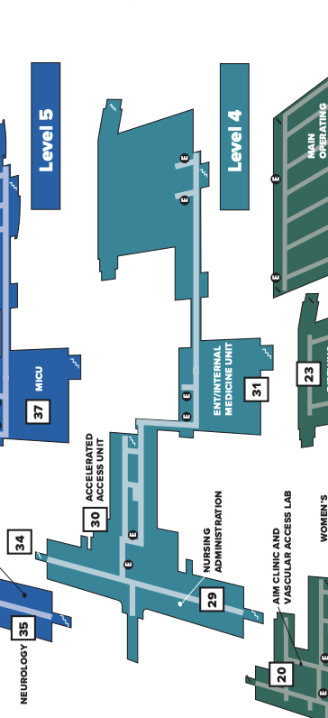
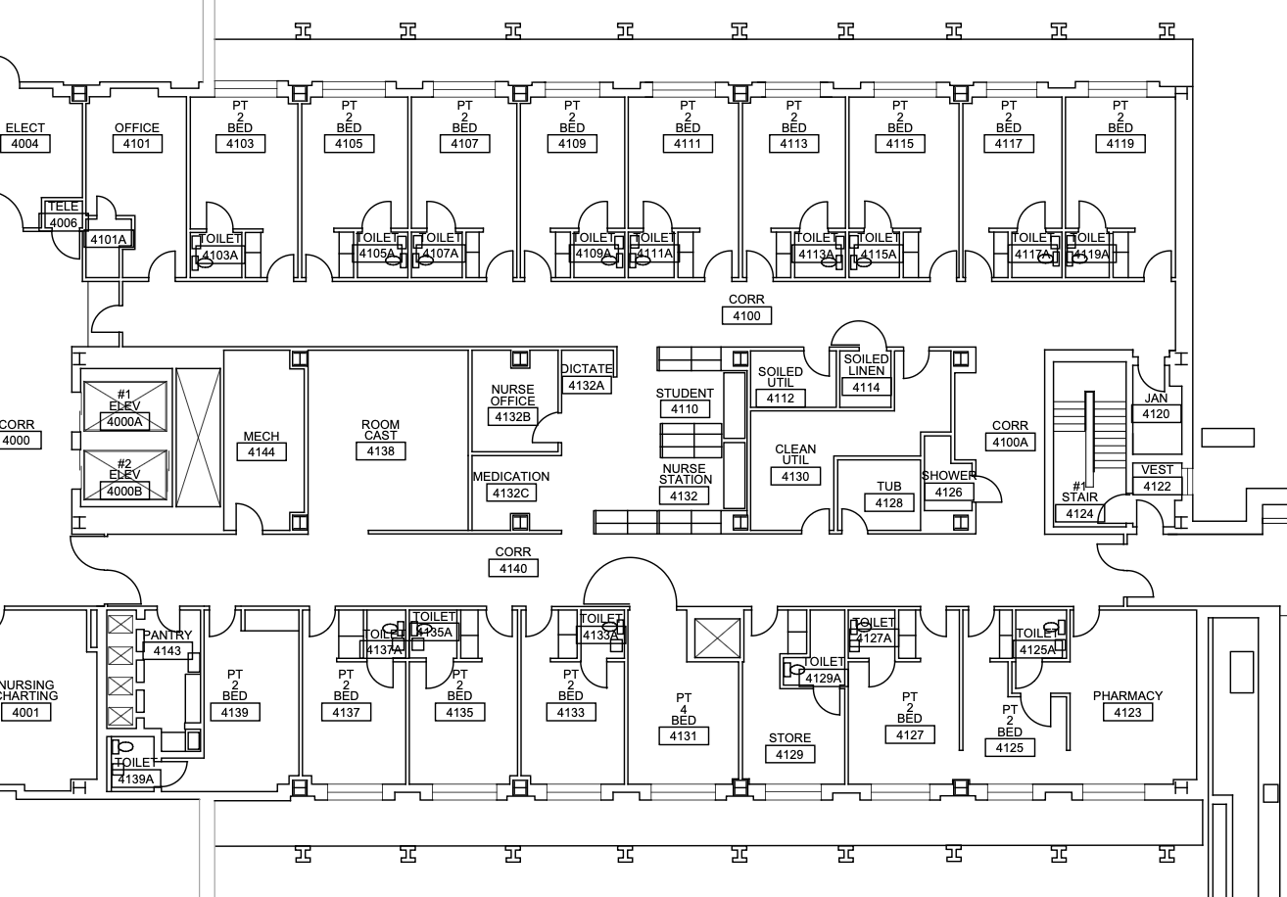
Community
Notes:
Our project utilizes UC Davis’s hospital airborne transmission data and seeks to understand and mitigate the spread of COVID outbreak on July 9th, 2020.
Using the hospital’s East 4th floor plan, we constructed a computational model in CONTAM to simulate the airflow dynamics and pathogen dispersal and analyze the spread of COVID-19 through survival analysis.

Slide 4


Team Introduction
Shane Chung: CSULB graduate student in Applied Statistics working on CONTAM modeling
Sowon Jung: CSULB graduate student in Applied Statistics major, performing literature review for CONTAM and project question

Slide 5


Team Introduction
Dan Le: CSULB undergraduate student in Biomedical Engineering major, looking into HEPA filters and their efficiency & cost on reducing airborne transmission disease.
Yiming Wang: CSULB graduate student in Applied Statistics major. Yiming is doing data analysis on HIPAA East 4 and the CONTAM simulation.

Slide 6
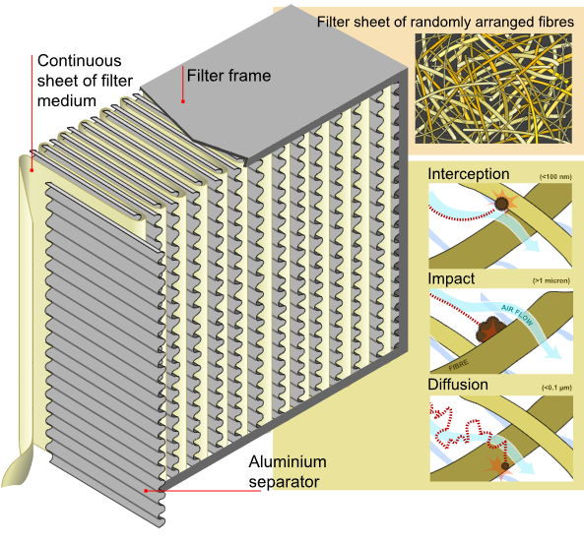
General Overview about HEPA filters
HEPA filters are essential for maintaining clean indoor air quality by effectively trapping airborne particles
Utilize multiple mechanisms for filtration
H14 grade removes 99.997% of particles.
Capture particles as small as 0.3 microns in diameter
HEPA filters intercept, impact and diffuse
Catches large particles
Catches smaller particles that got through the initial filter
Trapped by fibers within the filter
Notes:
Dan

Slide 7
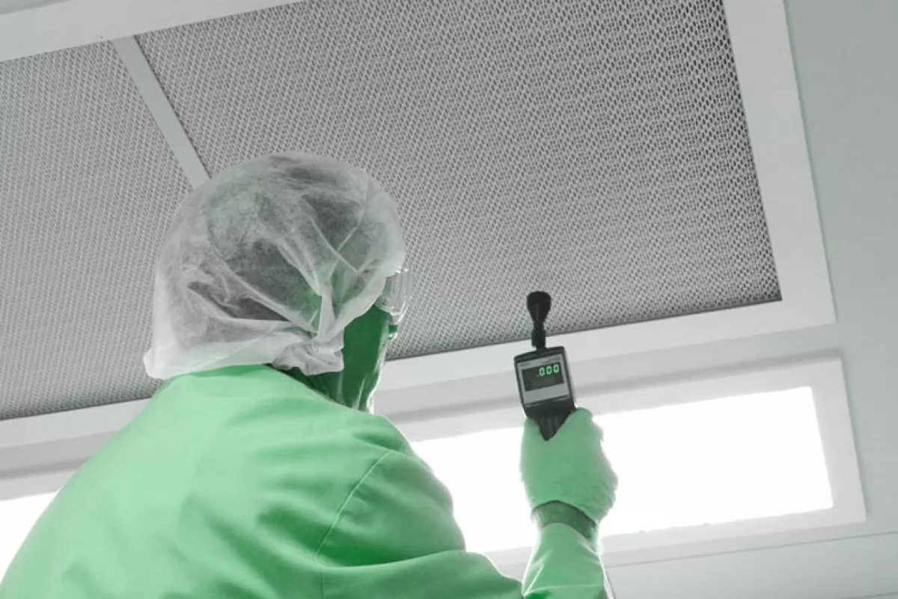
Costs HEPA filters
Cost of a single HEPA air filter is between $20 and $10,000
Hospitals often need to change out filters once every half a year at minimum
The average cost to replace one air filter is around $300
Solution thought/example
If a hospital replaced all 100 HEPA air filters it would be around $20,000
Each air filter is around $182
Camfil air filtration systems typically lower their HVAC energy costs by 15 to 30 percent
Notes:
Dan

Slide 8
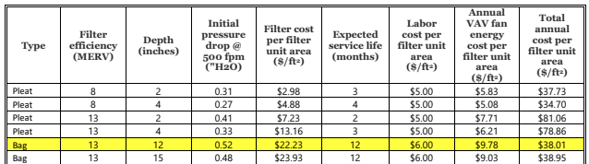
Literature Review
Technologies to mitigate airborne transmission
High-Efficiency Particulate Air (HEPA) Filters
Increasing filter MERV rating
Ventilation Control for Aerosol-Transmissible Pathogens in Healthcare
Method: dilution, filtration,disinfection,Pressurization, UVGI(Germicidal ultraviolet irradiation)
Bipolar Ionization
Air Purifiers / Hybrid ventilation / temporary negative-pressure rooms

Slide 9
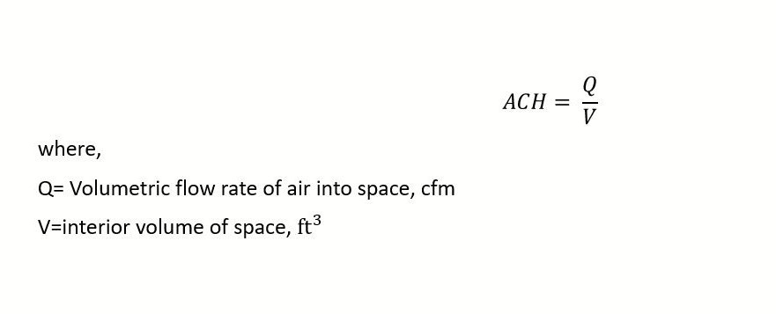

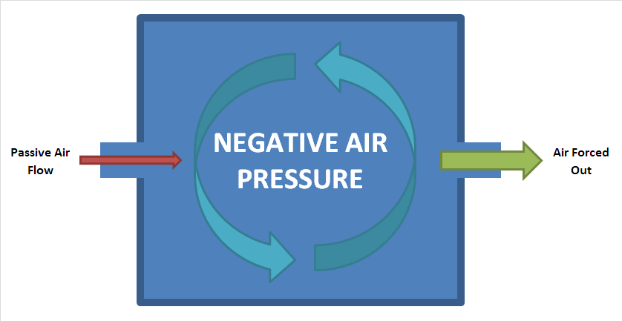
Literature Review (CONTAM Preparation)

Slide 10
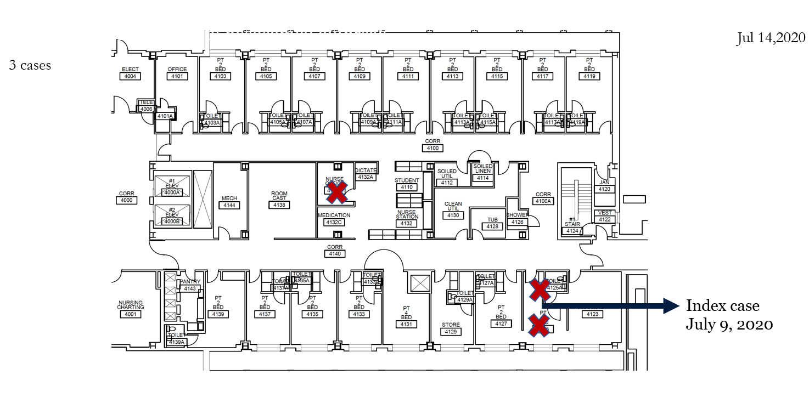
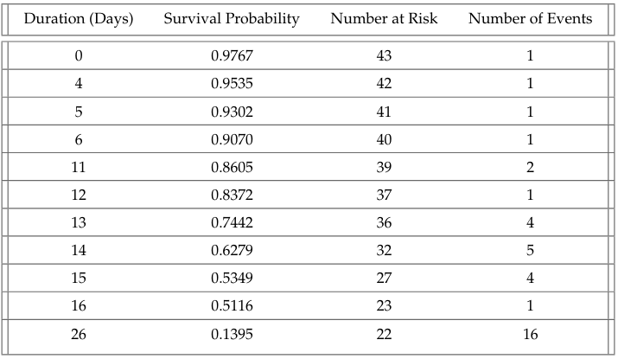
Data (Survival Analysis)
Example of Map of infection
Data: HIPAA Data East 4 Outbreak.
Date of Positive Covid-19 test
Patients’ contact information
Patients’ room numbers of Positive Covid-19 test
Analysis:
Visualization of maps of infection
Survival analysis using Kaplan-Meier Estimation
Challenges of Data:
Missing information for the positive COVID-19 test
Unbalanced sample sizes between staff and patient
Solution:
Combine the information from both the maps of infection and Excel data file and analysis
Focus on infections before the duration of 26 days when comparing staff group and patient group
Missing information for censored data for the duration of 26 days.
All samples on the duration of 26 days are patient
Kaplan-Meier Survivorship Table

Slide 11
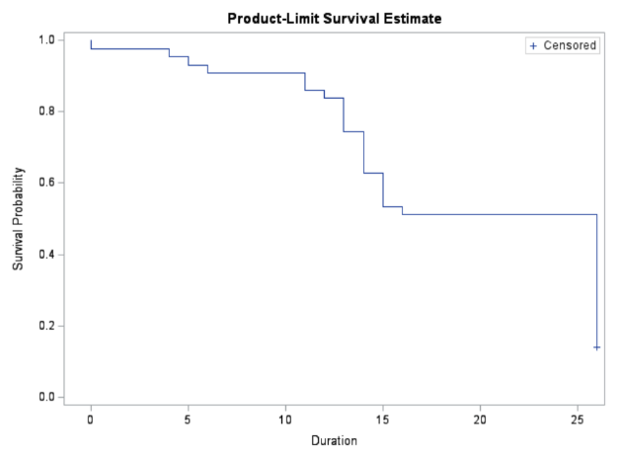
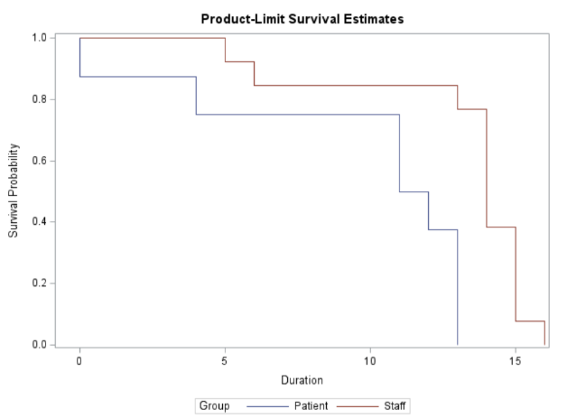
Kaplan-Meier Survival Curve
Data: KM Curve
Note: Survival Probability is the non-positive test probability
The initial survival probability is high at 97.67%, and drop down steadily before day 13. Between day 13 and day 15, there is a significant decline in survival curves (dropped from 0.8372 to 0.5349). The median survival time appears between day 16 and day 26.
From the stratified KM graph, we can see staff got COVID-19 later than patients, and based on the log-rank test p-value = 0.0008, we have enough evidence to conclude that there is a significant difference between staffs and patients.
Stratified Curve for Staff and Patient before day 26

Slide 12
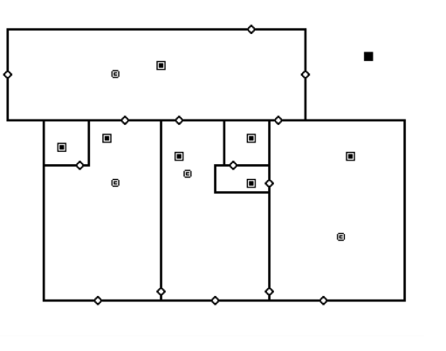
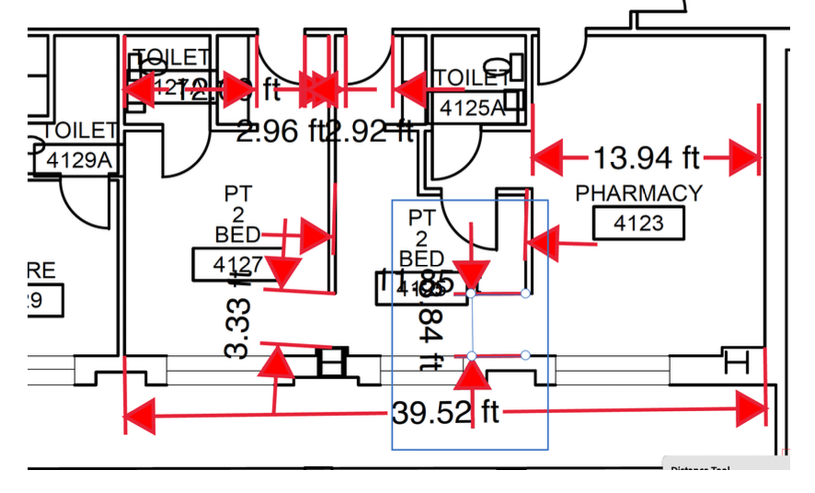
CONTAM: Sketchpad
Notes:
Shane

Slide 13
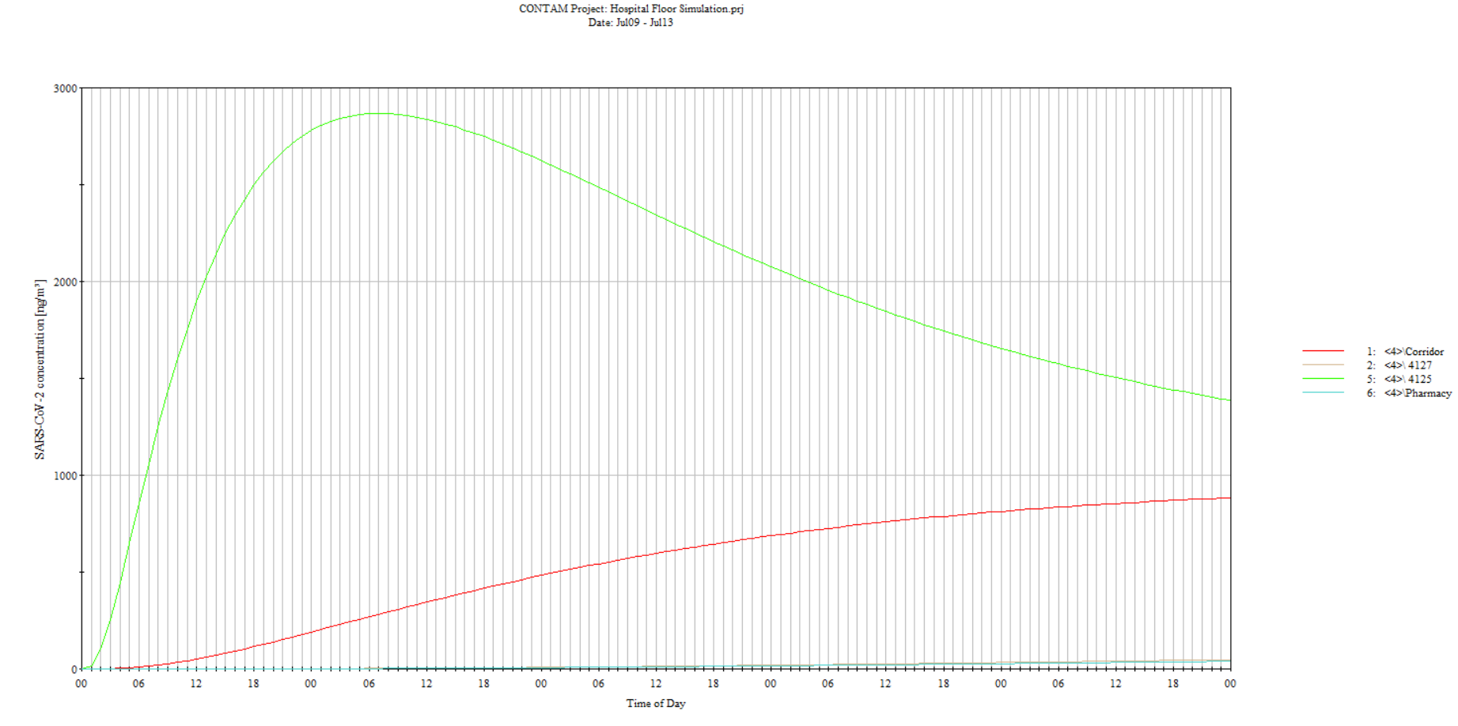

CONTAM: No Ventilation + No HEPA
Notes:
This graph illustrates the concentration of SARS-CoV-2 particles over a 96-hour period in a hospital with no ventilation and no HEPA filtration.
The green line represents the concentration in a patient room, showing a sharp increase and gradual decrease over time.
The red line, which represents the corridor, shows a much lower and steadier concentration which is due to the positive pressure from the patient rooms that sends the air towards the corridor
The slow yet significantly sustained increase of airborne disease concentration truly emphasizes the need for effective air management strategies in hospital settings

Slide 14
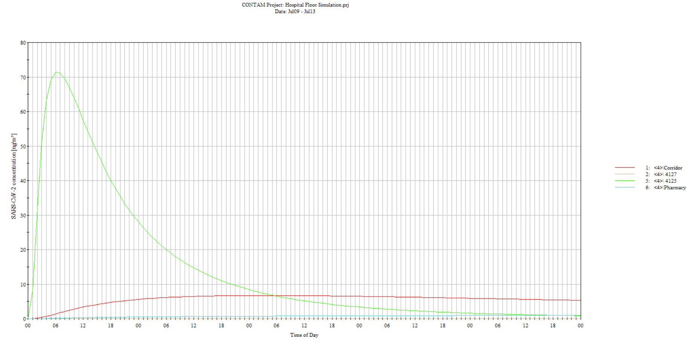

CONTAM: Ventilation + No HEPA
Notes:
This graph illustrates the concentration of SARS-CoV-2 particles over a 96-hour period in a hospital with ventilation but without HEPA filtration.
The sharp peak in the green line indicates a rapid increase in particle concentration in a patient room, which then declines significantly over time.
Meanwhile, the red line shows a consistently low concentration in the corridor.
This visualization highlights the effectiveness of ventilation in controlling airborne particles spread in larger, open areas compared to more confined spaces like patient rooms.

Slide 15
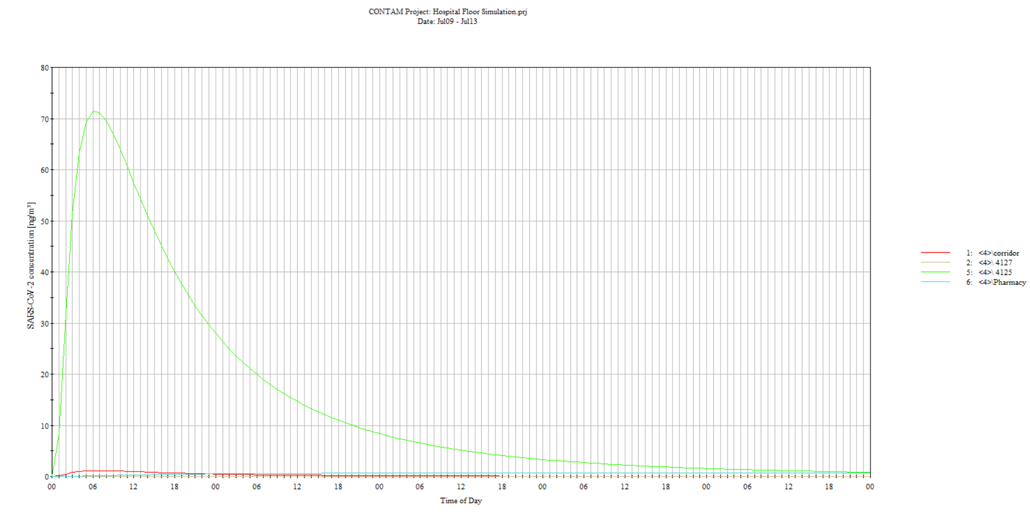

CONTAM: Ventilation + HEPA
Notes:
This graph demonstrates the impact of combining HEPA filtration with ventilation in a hospital setting. The green line peaks early but quickly reduces to near-zero levels, thanks to the efficient air cleaning methods.
The red line, representing the corridor, shows an even lower and more stable concentration throughout the day.
This setup highlights the critical role of both HEPA filters and proper ventilation in minimizing airborne viral particles and maintaining a safe environment

Slide 16

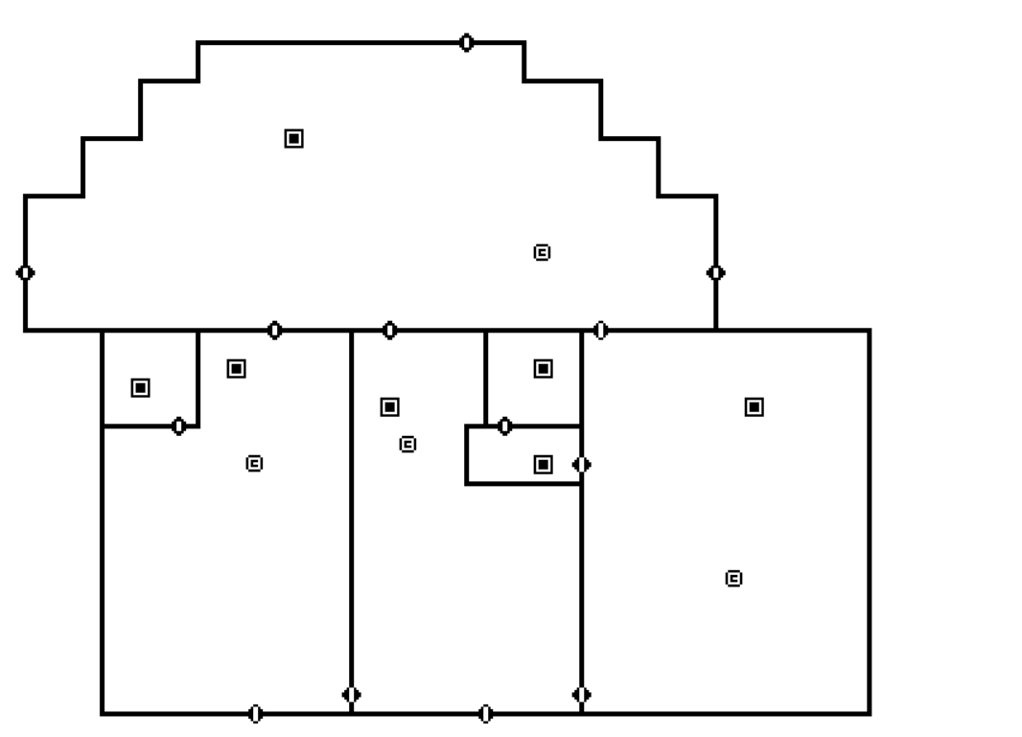
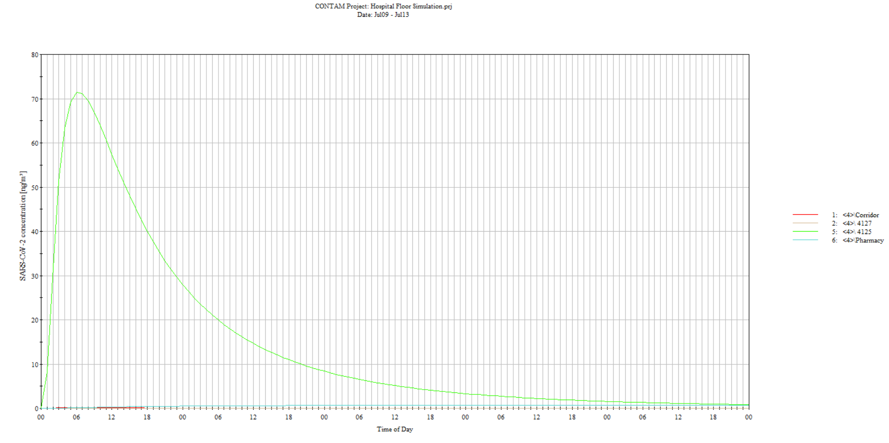
CONTAM: Spatial Redesign
Notes:
Reduction of cross sectional area in the flowpath

Slide 17
References
2020-10-14 Updated TE COVID19 White Paper
Preventing Aerosol-Transmissible Diseases in Healthcare Settings_ The Need for Protective Guidelines and Standards—Workshop Report
Engineering Solutions for Preventing Airborne Transmission in Hospitals with Resource Limitation and Demand Surge (https://www.ncbi.nlm.nih.gov/pmc/articles/PMC8138644/pdf/ijccm-25-453.pdf)
Bipolar ionization rapidly inactivates real-world, airborne concentrations of infective respiratory viruses (https://journals.plos.org/plosone/article?id=10.1371/journal.pone.0293504)
Ventilation strategies to reduce airborne transmission of viruses in classrooms: A systematic review of scientific literature (https://www.ncbi.nlm.nih.gov/pmc/articles/PMC9259197/)
Engineering Solutions for Preventing Airborne Transmission in Hospitals with Resource Limitation and Demand Surge (https://www.ncbi.nlm.nih.gov/pmc/articles/PMC8138644/)
Hospital HVAC: Hospital Air Filters Seem Inexpensive - Now Prove Costly Later https://cleanair.camfil.us/2011/04/18/hospital-discovers-that-air-filters-that-seem-inexpensive-now-prove-costly-later/

Slide 18



THANK YOU!!!!

